Slide 1
WELCOME

Slide 2

Don't Leave Money on the Table Maximize your WPUNJ Benefits
Presented by:
Peter Lazzaro, Director of Benefits and Leave Management

Slide 3
The Purpose: Why Maximizing Your WPUNJ Benefits Matters?
Wellness & Mental Health Support
NJWELL, Horizon BFit, Talkspace, and the Employee Assistance Program offer free or low-cost fitness, counseling, training, and consultation services.
Out-of-Pocket Savings
FSA (Tax Save) and Vision Reimbursement help you pay less for everyday healthcare expenses.
Education & Career Growth
Tuition Waiver and EAP training programs support your professional development at little to no cost.
Financial Planning for Your Future
One-on-one guidance from 401(a), 403(b), and 457(b) customer representatives helps you make informed retirement decisions.

Slide 4
What is NJ Well?
NJWELL rewards eligible members and their covered spouses/partners for completing health and wellness activities in the state health plan.
  Complete the required health assessment and health screening; then choose other online or in-person wellness activities in five different categories to reach 800 points – and earn your reward valued at $250 or more.
  Eligible members are those who participate in the medical plan. If you waive this and only use the dental, you are not eligible for the NJ Well program.

Slide 5
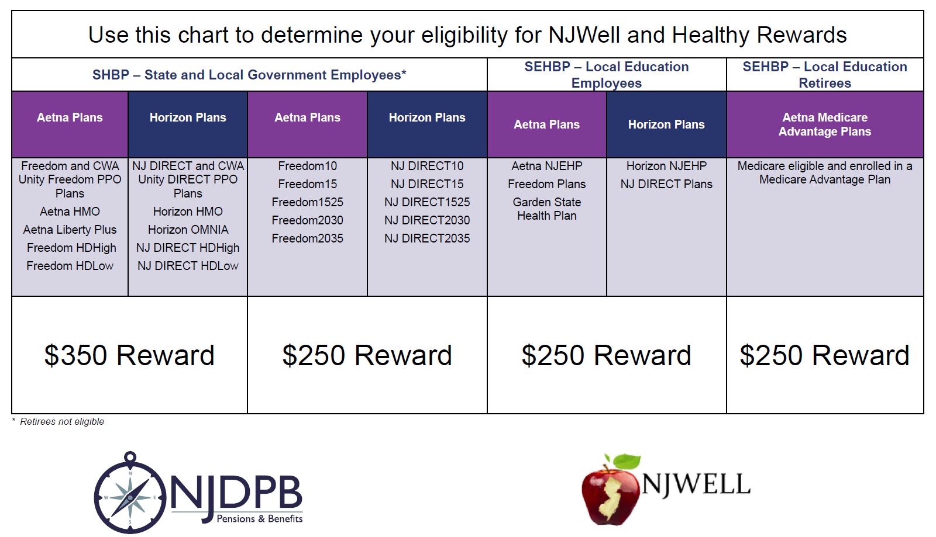

Slide 6
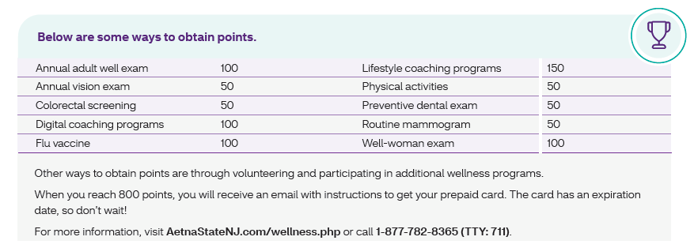

Slide 7
Horizon Be Fit Program/Aetna Fitness Reimbursement
Horizon Be Fit Program/Aetna Fitness Reimbursement
  10,000 steps at least 12 times/month = $20 ($240/year)
  Horizon: Connect your smart device/watch to the ActiveFit app
  Aetna: Sign up though Member Portal; Register and enter personal information.
    Site will prompt member to upload proof of 12 workouts within a 1-month period
Blue365 Program/Aetna Discount Programs that you can save on:
Cookbooks, meal plans and nutrition programs, Fitness clothing and equipment, Child safety products, Health magazines, glasses and contacts, And much more!

Slide 8
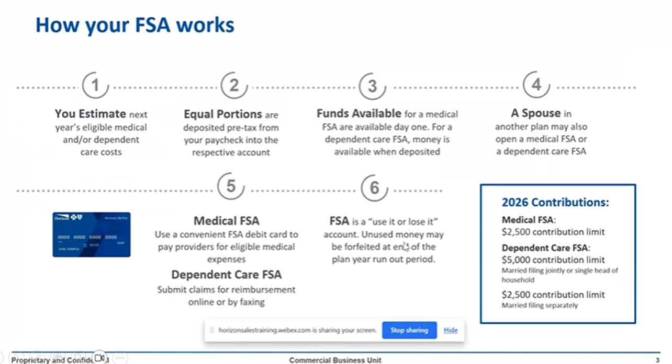
FSA (Tax Save)

Slide 9
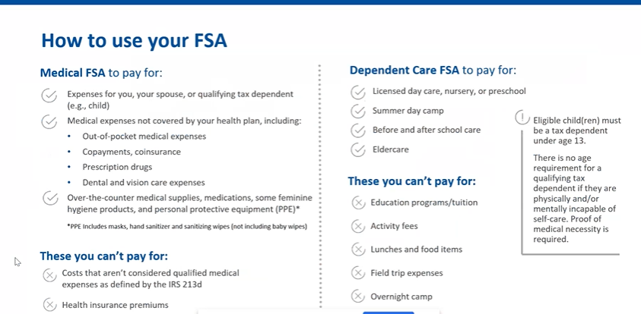
FSA (Tax Save) cont.

Slide 10
FSA (Tax Save) cont.
How does this save you money?
  FSA Dependent Care $5000
    20% Marginal Federal Tax Rate = Savings of $1000
    FICA = Social Security (6.2%) + Medicare (1.45%) = 7.65% = Savings of $382.50
      Total Tax Savings = $1328.50
  FSA Medical $2500
    20% Marginal Federal Tax Rate = Savings of $500
    FICA = Social Security (6.2%) + Medicare (1.45%) = 7.65% = Savings of $191.25
      Total Tax Savings = $691.25

Slide 11
Vision Reimbursements
William Paterson University provides a Vision Care Program for full-time employees and eligible dependents, offering reimbursements every two years (2025-2027 cycle) for vision services.
Benefits include up to ($45) for eye exams, ($80) for single-vision lenses/contacts, and ($90) for bifocal/progressive lenses. Claims require an itemized receipt submitted to Human Resources.
Dependents are eligible until the end of the year of their 26th birthday.
Steps
  Fill Out the Fillable PDF, Upload with receipts in Workday,
  Directions QRG under Benefits, Vision Reimbursement
  https://wpconnect.wpunj.edu/workday/qrg/Benefits/Change%20Benefit%20_Submit%20Vision%20Reimbursement%20Request%20November%202025.pdf

Slide 12
Higher Education EAP
Free employer-provided benefit to assist employees and family members with:
Counseling
Peak Performance Coaching
Resources and referrals
Training
Legal Consultation

Slide 13
Higher Education EAP cont.
Who’s covered?
You & family members living in your home
Dependent children up to the age of 26

Slide 14
Higher Education EAP cont.
Legal Benefit
Designed to help you with personal legal issues
Wills, Traffic Violations, Divorce, Custody and more
There is no charge for your initial phone consultation (up to 30 minutes)
If you need to hire an attorney, the billable hourly rate is discounted by 25%
Entire legal library on the EAP website which includes: Will and Power of Attorney templates, contract samples and more
The legal benefit is not available for issues related to employment or medical concerns

Slide 15
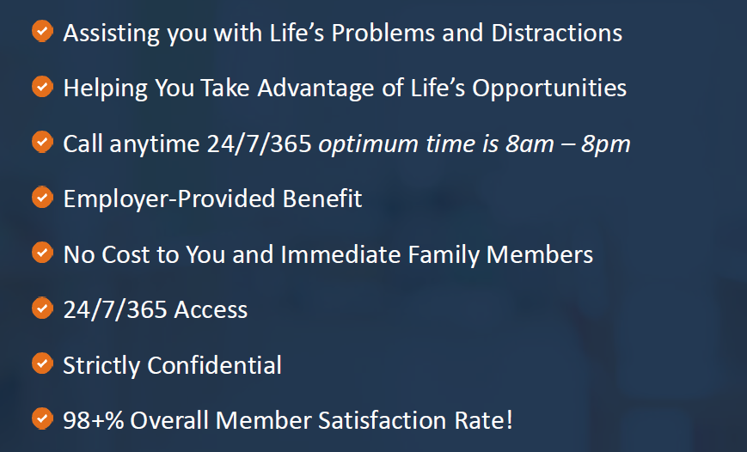
Higher Education EAP Recap.

Slide 16
Talk Space Go App
All members can improve mental health and wellbeing in just 5 minutes a day with self-guided programs for individuals, couples, and parents.
400+ self-guided, interactive courses
Live weekly therapist-led anonymous group classes
Assessments, meditation exercises, journaling, & reminders
Address anxiety, stress, burnout, trust, & more
Use organization code: ESIEAP

Slide 17
Tuition Waiver Policies
AFT, AFT Adjunct Unit, CWA, IFPTE, Higher Education Managers, PBA, and FOP
Dependent Children of Full Time Employees
https://www.wpunj.edu/human-resources/total-rewards/benefits/tuition-assistance-programs

Slide 18
Sources of Your Retirement Income
Social Security
Defined Contribution Plan or 401(a) Pension or Defined Benefit Pension Plan (PERS)
Voluntary Supplemental Retirement Plans 403(b) and or 457(b) plans
Part Time Employment
Rental Property
Inheritance
Lottery Winnings

Slide 19
Financial Wellness
401 (a) Vendor List
TIAA
VOYA
Corebridge Financial
Equitable
MetLife/Brighthouse
Empower
403 (b) Vendor List (ACTS) Additional Contributions Tax Sheltered
TIAA
VOYA
Corebridge Financial
Equitable
MetLife/Brighthouse
Empower
457 (b) NJSEDCP NJ State Employee Deferred Compensation
Empower

Slide 20
Financial Wellness cont.
401 (a) Vendor List
Defined Contribution Plan
8% State of NJ
5% Employee
403 (b) Vendor List (ACTS) Additional Contributions Tax Sheltered
Voluntary Supplemental Retire
457 (b) NJSEDCP NJ State Employee Deferred Compensation
Voluntary Supplemental Retire
NOTE: Onboarded - Default Vendor - Stable Value Fund

Slide 21
Financial Wellness cont.
401 (a) and 403(b) and or 457(b)
Contact the Customer Representative of your plan and schedule a consultation
Utilize the tools such as the Retirement Calculator to assist in obtaining your goals
Visit with the Representative at a minimum of 1 time each year

Slide 22
Comments and Q & A

Slide 23
Thank you!

